Slide 1
Ain shams University computer science Department:Information System
Mohamed Ismail Mahmoud (sec:2)
Mina maher talaat (sec:5)
Andrew Amin raghb (sec:2)
Andrew Emad shafeek (sec:2)
Alaa eldin Mohamed mahrous (sec:3)
Supervised by Dr.Sherin Rady & TA.Mariam Mohammed Hassanein

Slide 2
Data visualization analytics conclusion
Earthquakes

Slide 3
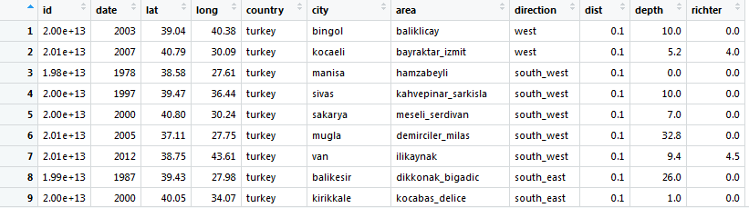
View(earthquake)

Slide 4

Preprocessing:
>earthquake$dist=ifelse(is.na(earthquake$dist),ave(earthquake$dist,FUN =function(x)mean(x,na.rm = TRUE)),earthquake$dist)
Now we don’t have missing values in numerical columns

Slide 5
Removing missing values from categorical columns
>earthquake<-na.omit(earthquake)

Slide 6
Data set contains earthquakes about countries but after removing null values from categorical data, country is turkey
length(which(earthquake2$country=="turkey"))

Slide 7
Visualization

Slide 8
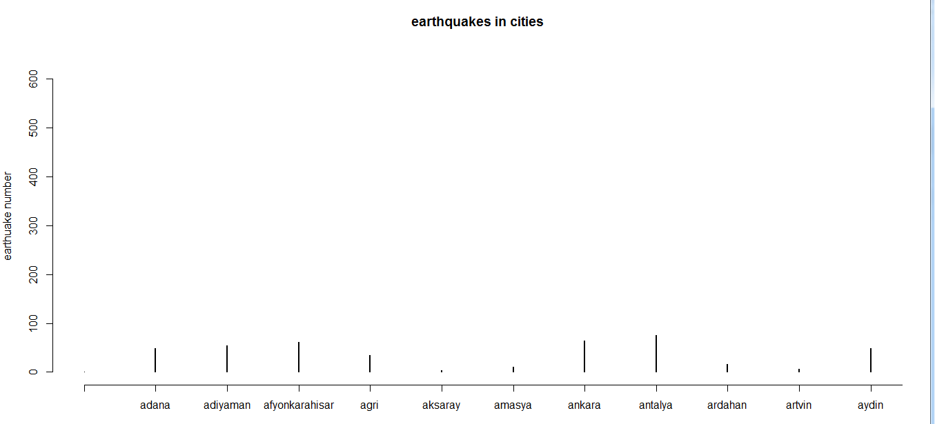
We want to know which city in turkey had longest number of earthquakes. >earthquakesincity<-table(sort(earthquake$city[earthquake$richter>0])) >plot(earthquakesincity,xlim=c(1,12),main="earthquakes in cities",ylab="earthuake number",xlab="cities")

Slide 9
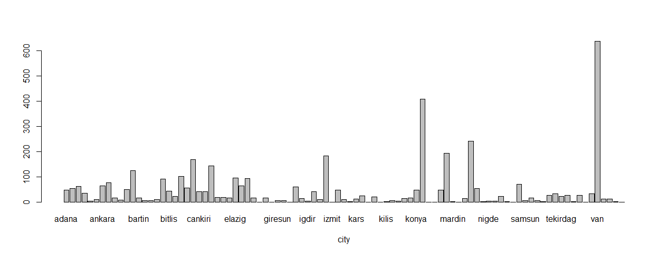

Slide 10
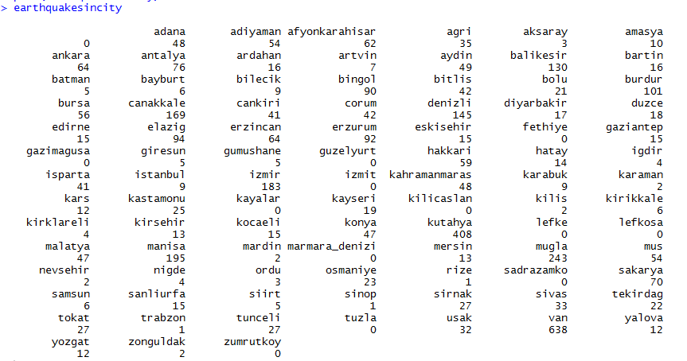
>earthquakesincity now city “van” in turkey had largest number of earthquakes

Slide 11
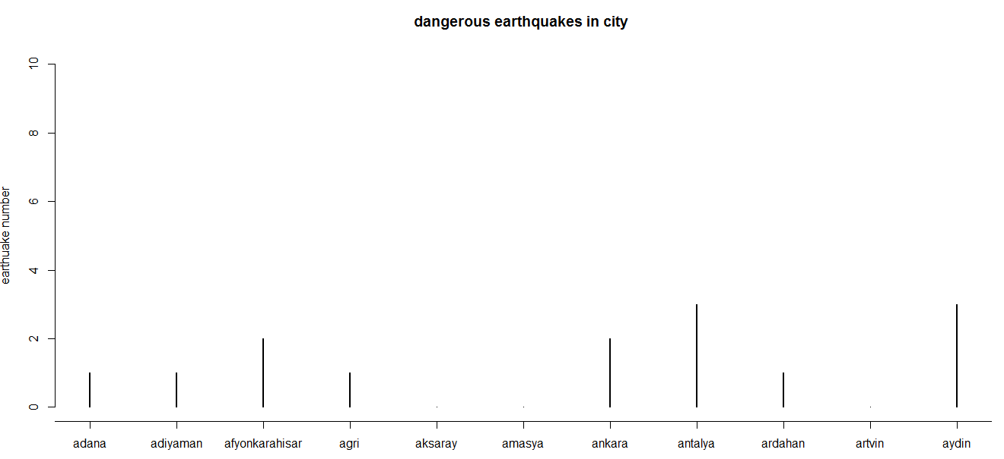
but which city has dangerous earhquakes >dangerous.city.earthquake<-table(sort(earthquake$city[earthquake$richter>=5.5])) >plot(dangerous.city.earthquake,xlim=c(1,12),main="dangerous earthquakes in city ",ylab="earthuake number",xlab="cities")

Slide 12
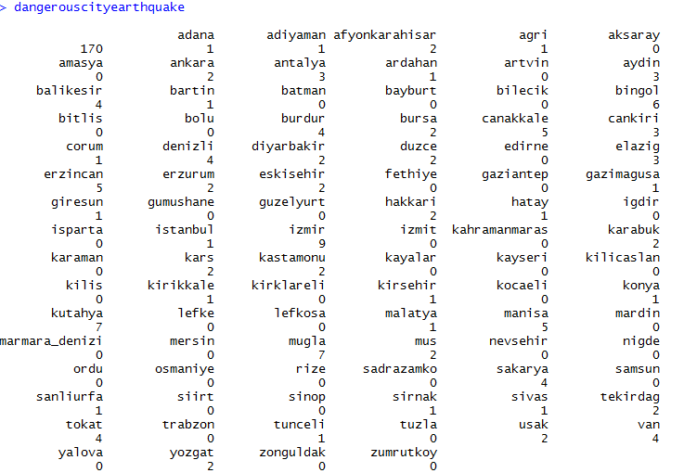
>dangerouscityearthquake all these cities are most affected by dangerous earthquakes “mugla” , ”Kutahya” ,”Izmir” are cities that are most affected with severe earthquakes

Slide 13
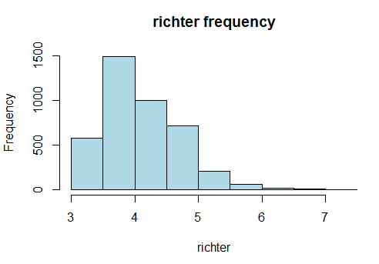
hist(earthquake2$richter[!earthquake2$richter==0],col="lightblue",xlab="richter",main="richter frequency")

Slide 14
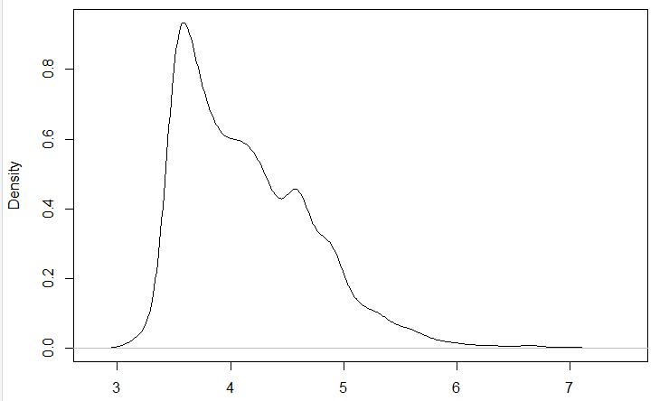
richter<-density(earthquake2$richter[!earthquake2$richter==0]) plot(richter)

Slide 15
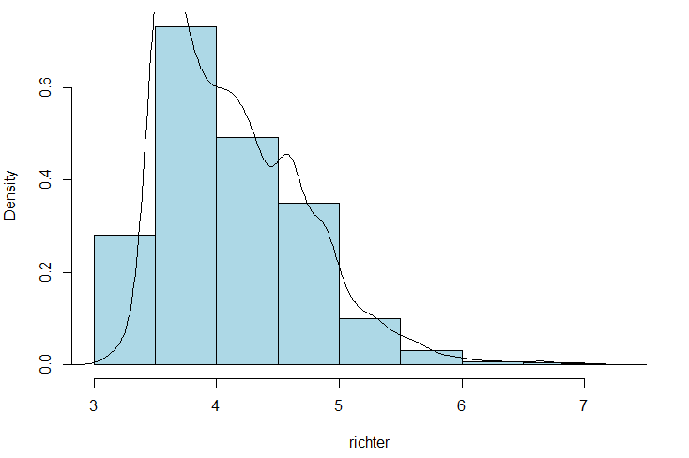
hist(earthquake2$richter[!earthquake2$richter==0],col="lightblue",xlab="richter",main="richter frequency",freq = F) lines(richter)

Slide 16
>earthquake2$scale[earthquake2$richter >= 8] <- "Great Damage“
>earthquake2$scale[earthquake2$richter >= 7 & earthquake2$richter<= 7.9]<-"Serious Damage"
>earthquake2$scale[earthquake2$richter >=6.1 & earthquake2$richter<=6.9]<-"Severe Damage“
>earthquake2$scale[earthquake2$richter >=5.5 & earthquake2$richter<=6]<-"Slight Damage"
>earthquake2$scale[earthquake2$richter >=2.5 & earthquake2$richter<=5.4]<-"Minor Damage"
>earthquake2$scale[earthquake2$richter <= 2.5] <- "Limited Damage"
>ggplot(data=earthquake_scale, aes(x = scale, y = n, fill = scale))
geom_bar(stat = "identity") +
xlab("Earthquake Magnitude by Scale") +
ylab("Total Earthquakes") +
ggtitle("Global Earthquake Magnitude Scale") +
theme(axis.text.x = element_text(angle = 45, hjust = 1)) +
theme(plot.title = element_text(hjust = 0.5))

Slide 17
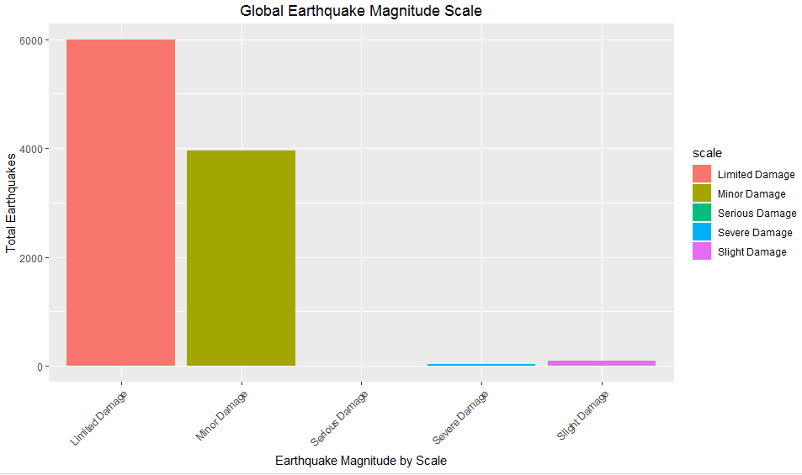

Slide 18
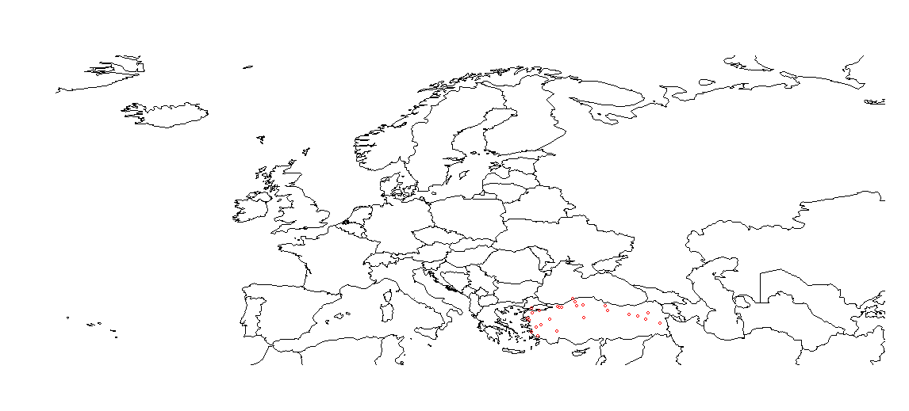
library(rworldmap) newmap <- getMap(resolution = "low") plot(newmap, xlim = c(-20, 59), ylim = c(35, 71), asp = 1) points(earthquake2$long[earthquake2$richter>6], earthquake2$lat[earthquake2$richter>6], col = "red", cex = .6)

Slide 19
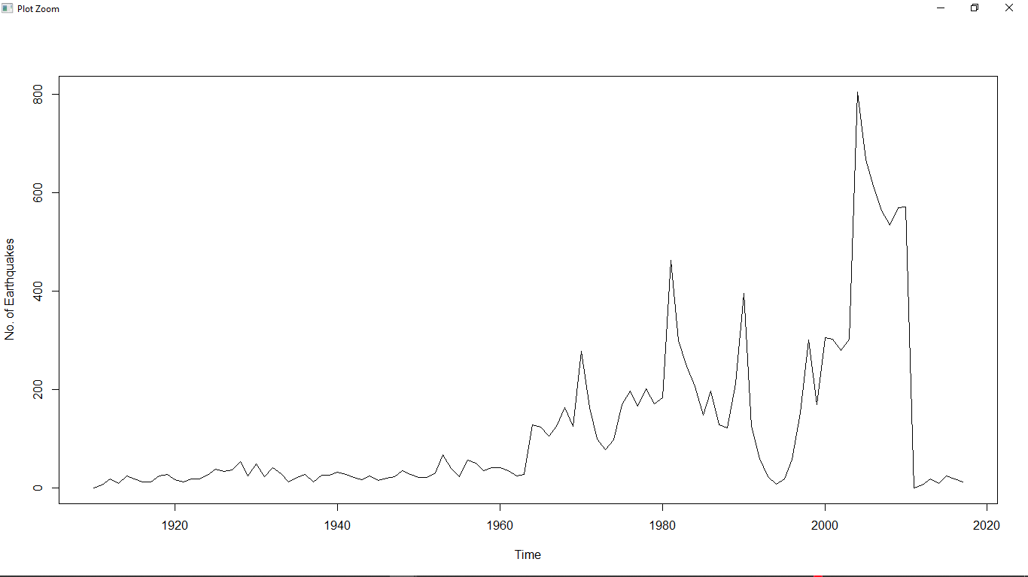
Here is a time series for the data from 1910 to 2017

Slide 20
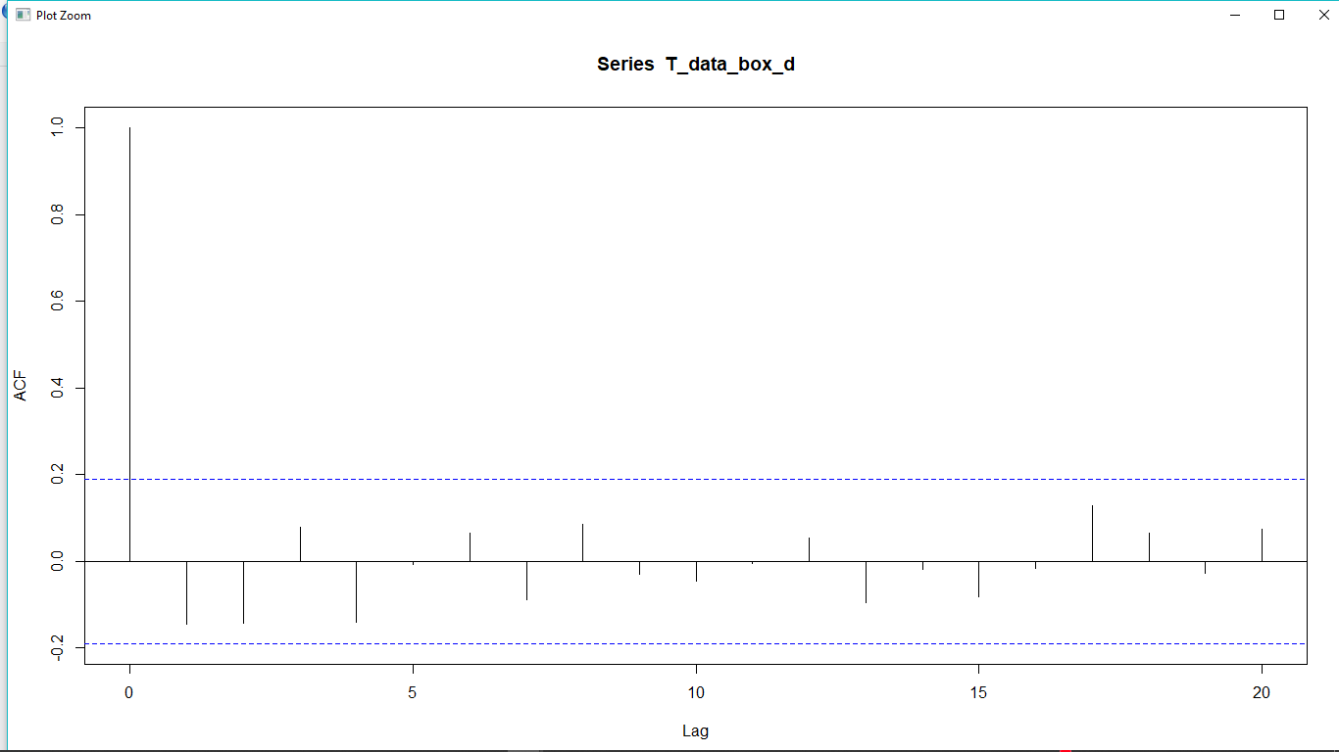
ACF

Slide 21
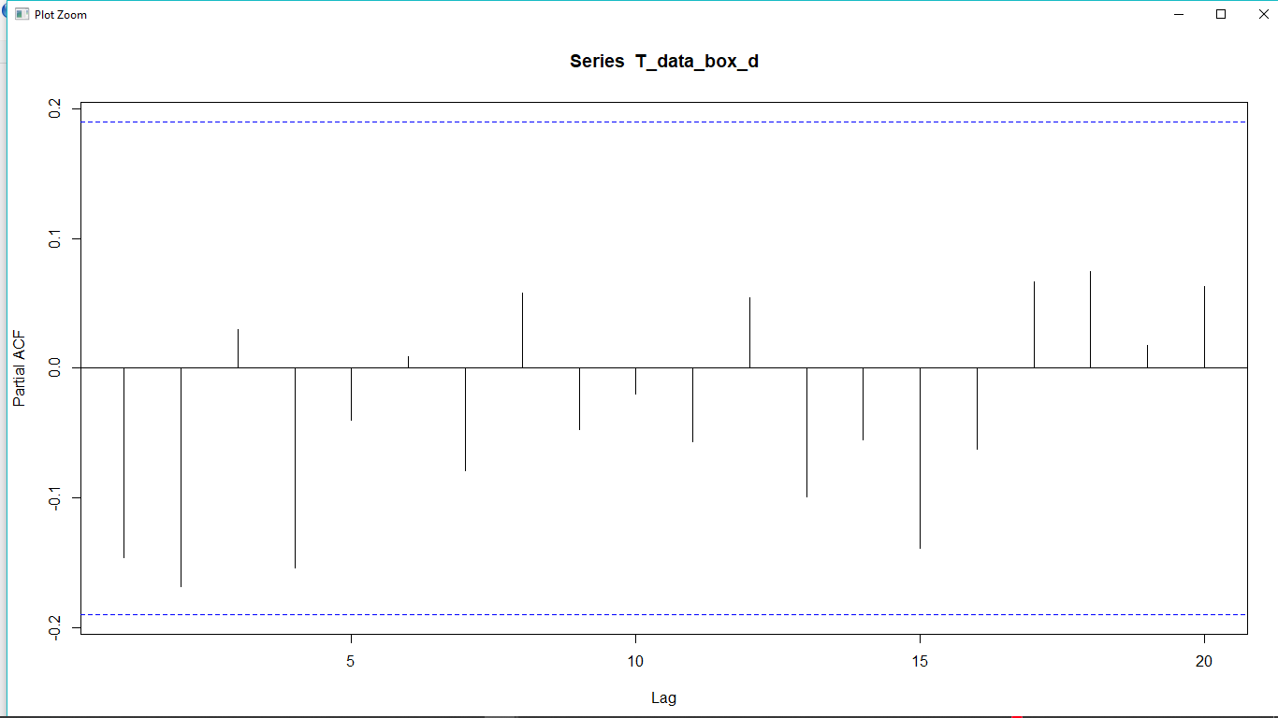
PACF

Slide 22
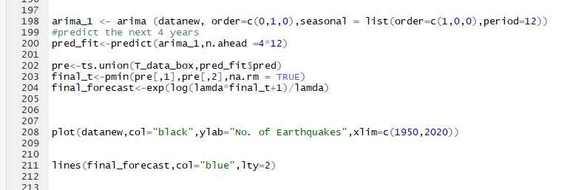
Build the Model

Slide 23
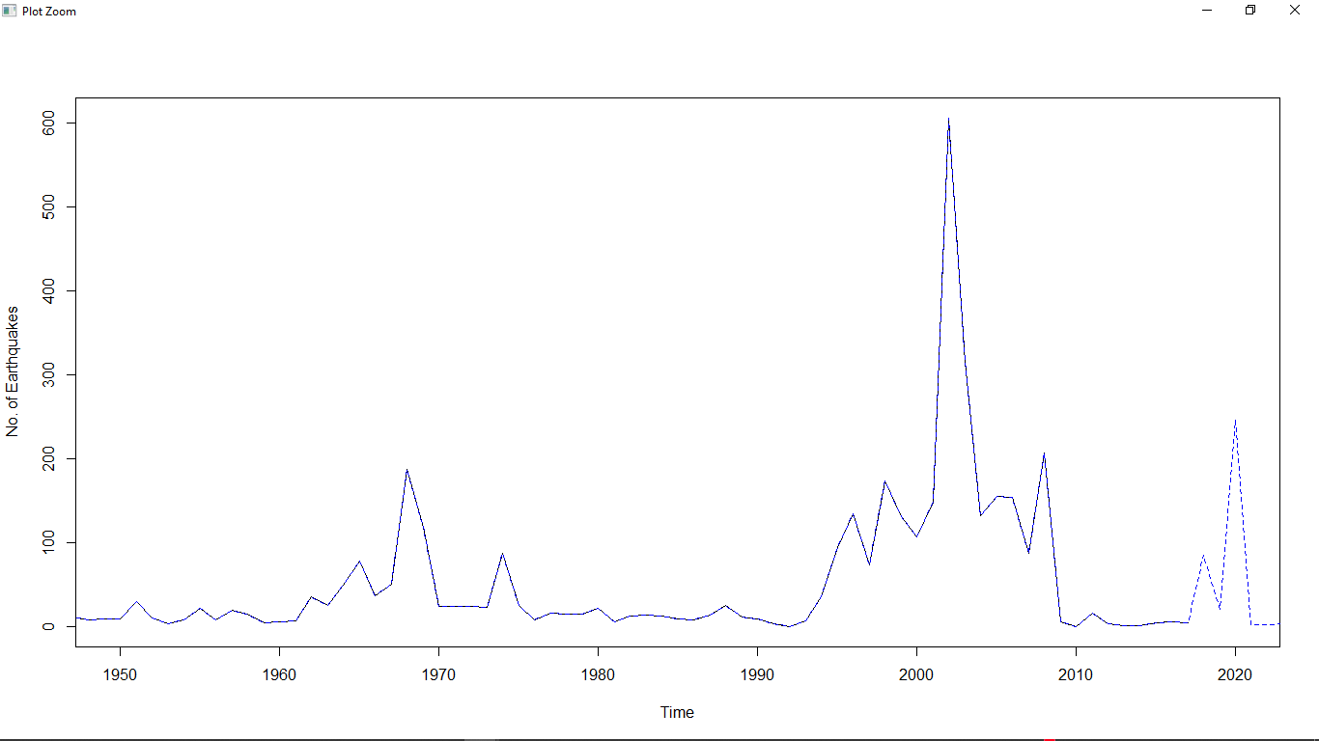
Prediction

